Slide 1
Protecting Your PII during COVID times

Slide 2
What is PII? (Personal Identifiable Information)
PII is anything that identifies you and “Only You” as the very own individual
For example: your Social Security Number (SSN).
PII is the primary attack surface to Identity Theft in the US
SSN is directly associated to you / ‘primary-key’ of your Personal Data
Similar to what a VIN is to a vehicle or ISBN is to a book, etc
Other Critical PII
Driving license
Your email
Your signature
Your passport #
Your bank / credit card account #s (financial records)
Your medical records >>> Protected Health Information (PHI)
Your ‘full name’ & birthday
Your phone number (active) ***

Slide 3
Your Credentials & Data (Opt-Out Method)
CA Consumer Privacy Act (CCPA) (Eff. January 1, 2020)
“your right & request to delete your PII” / Out-Out
Impact
Your credentials, PII could be sold & be on Dark Web
2020 Prediction: immerse privacy breach due to CCPA in place
Advisory
Search yourself online
Contact Data Brokers (Email, Cust. Service Phone, Opt-Out footnote option)
Provisions made for CA Residents per PRIVACY RIGHTS

Slide 4
Top Data Brokers
Instantcheckmate
Spokeo
Peoplewhiz
Beenverified
Checkpeople
Peekyou
Nuwber
Truepeoplesearch
Truthfinder
Mylife
411
Ancestry
Whitepages
USSearch
Peoplesmart
Everify
Onerep
Intelius
Callersmart
Instantpeoplefinder
Myrelatives
Radaris
Gladiknow
Number2name

Slide 5
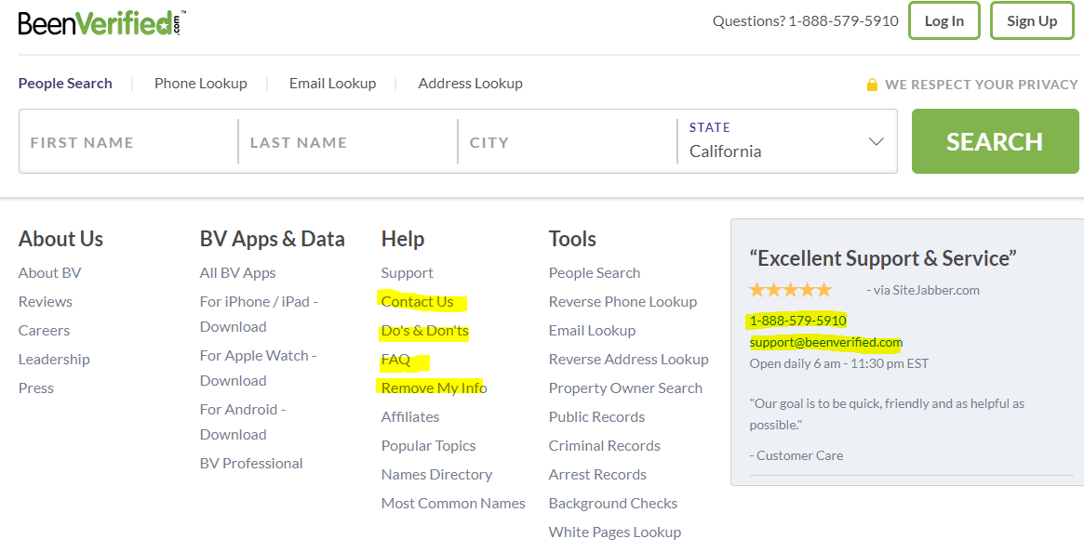
“How to Opt-Out” Process!
Example 1: Been Verified (https://www.beenverified.com/)
Ways to Opt-Out: email, call or form online

Slide 6
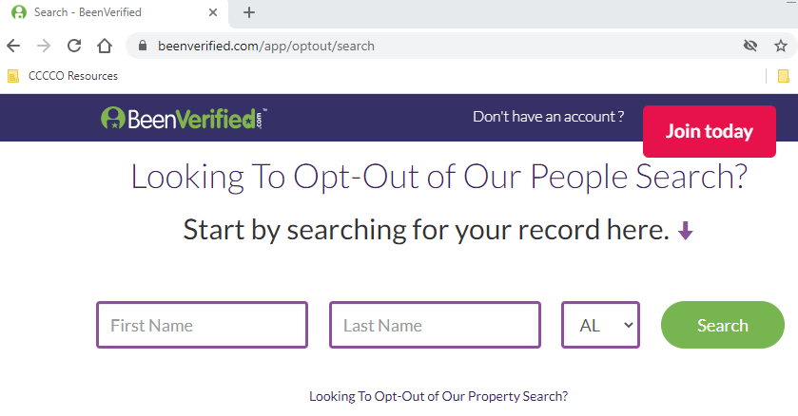
“How to Opt-Out” Process!
Example 1: Been Verified (https://www.beenverified.com/)
Removing information:

Slide 7
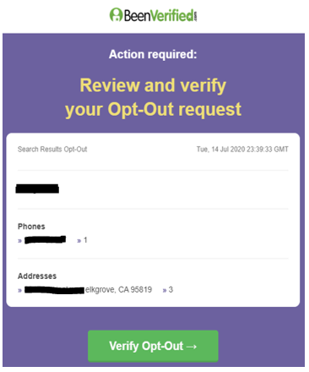
“How to Opt-Out” Process!
Example 1: Been Verified (https://www.beenverified.com/)
Confirmation:
-Some removals are instant.
-Some do take 24 to 48 hrs.
-Recheck after a week.

Slide 8

“How to Opt-Out” Process!
Example 2: https://nuwber.com
Ways to Opt-Out: email, call or form online
‘Contact Us’ has a opt-out link as well

Slide 9
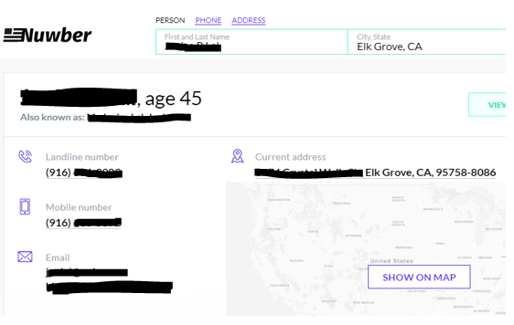
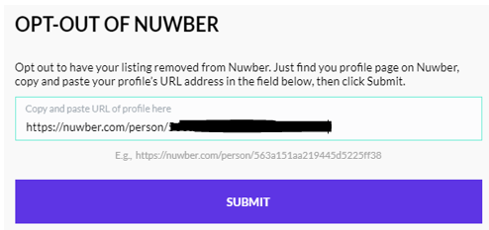
“How to Opt-Out” Process!
Example 2: https://nuwber.com
Removing information: Search yourself and get URL specific to your profile

Slide 10
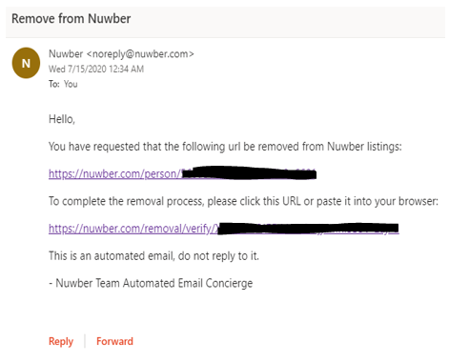
“How to Opt-Out” Process!
Example 2: https://nuwber.com
Confirmation:

Slide 11
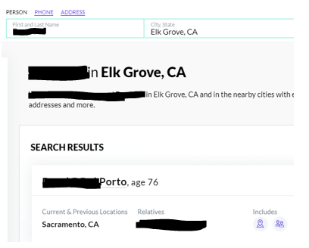
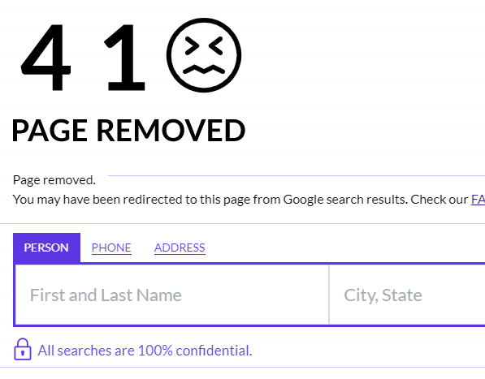
“How to Opt-Out” Process!
Example 2: https://nuwber.com
Confirmation: Search yourself or verify

Slide 12
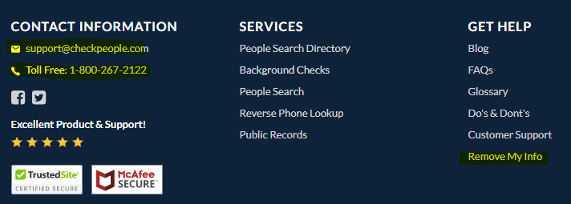
“How to Opt-Out” Process!
Example 3: https://checkpeople.com
Ways to Opt-Out: email, call or form online

Slide 13
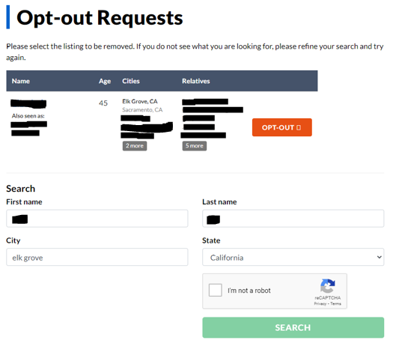
“How to Opt-Out” Process!
Example 3: https://checkpeople.com
Removing information:
Search yourself

Slide 14
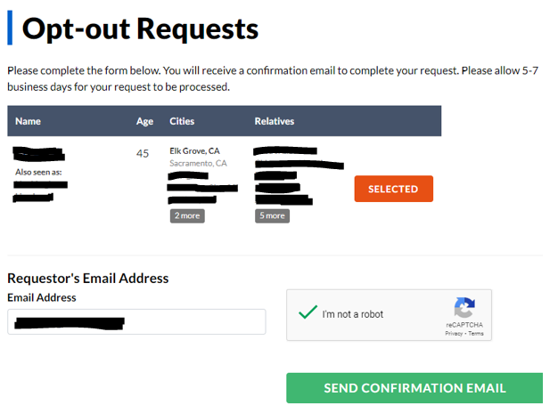
“How to Opt-Out” Process!
Example 3: https://checkpeople.com
Removing information:

Slide 15
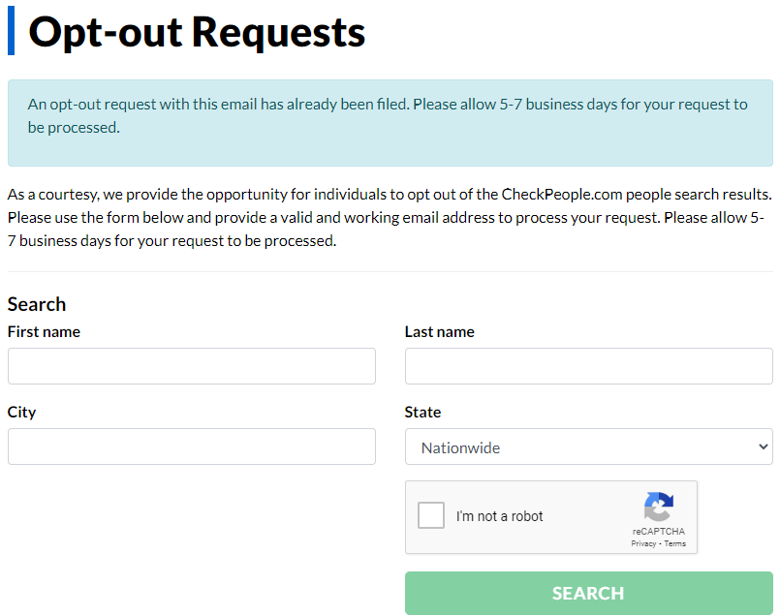
“How to Opt-Out” Process!
Example 3: https://checkpeople.com
Removing information:

Slide 16
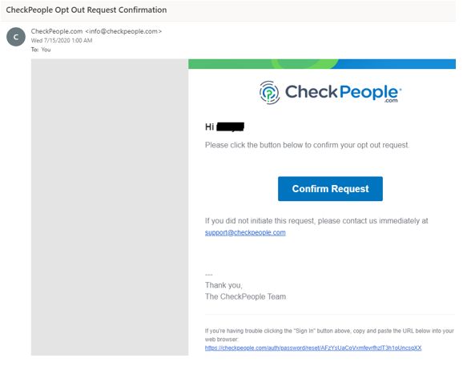
“How to Opt-Out” Process!
Example 3: https://checkpeople.com
Confirmation:

Slide 17
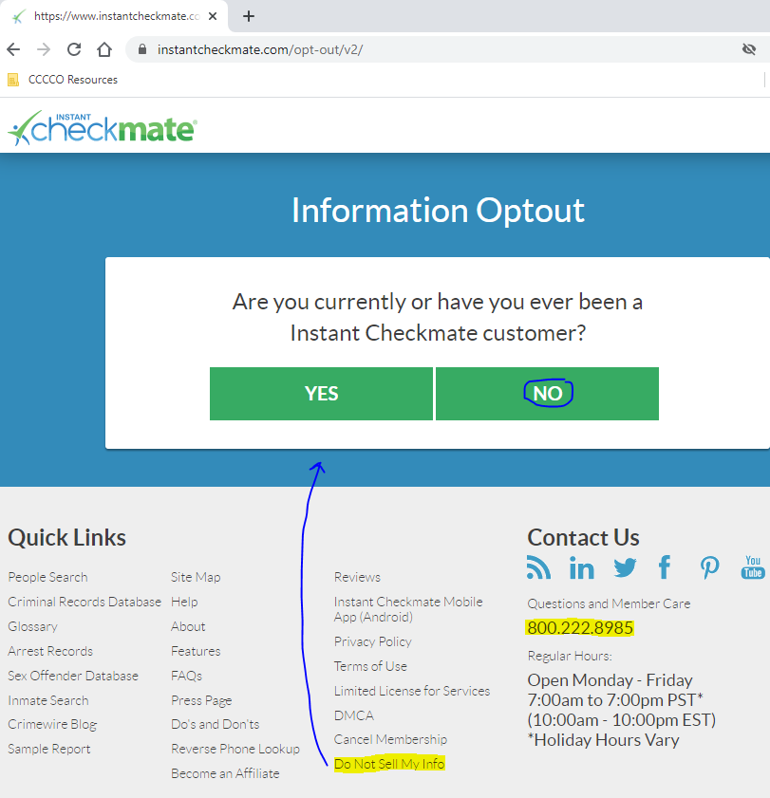
“How to Opt-Out” Process!
Exercise: DIY, try
Instant CheckMate

Slide 18
“How to Opt-Out” Process!
Process Summary:
Step 1: Choose a contact method with the data broker: phone, email or using opt-out form link (in the footnotes of the data broker website)
Step 2: Search yourself on the website if using a form removal method OR give your name and necessary PII to representative on the phone. If emailing then provide: the necessary PII or URL where your profile/data is located
Step 3: Remove yourself using the walk-through process via the opt-out form
Step 4: Confirm your request (email will be sent to you if using opt-out form)
Step 5: (Optional) Verify yourself that you have been removed for whatever data broker(s) you interacted with.

Slide 19
What is Vishing & SMShing ?
Vishing (Portmanteau of voice & phishing)
form of criminal phone fraud, using social engineering over the telephone system to get access to private personal and financial information for the scammer’s personal gain. Phishing via phone is where the scammer (or recording) warns you of urgent need to confirm or provide sensitive account information
SMShing (SMS Phishing)
sending fraudulent text messages to get one’s personal details by masquerading as a trustworthy entity. Essentially, phishing via text directs you to follow a link or call to provide sensitive account information
Recent Attacks: There has been recent attempts by Cyber Criminals (disguising as trustworthy individuals), calling [vishing] or texting [SMShing] employees and asking for personal/financial details.

Slide 20
Vishing & SMShing Advisory (Awareness)
Advisory
Take precautions when subject to such calls or texts.
Do not answer calls or respond to texts that seen very unfamiliar, especially to robocalls. Correspondence will identify you as a real person and validating your phone number; and this causes the threat actors to retain your phone details, where they continue making communication with you.
If you receive a call and immediately hear the phrase “Can you hear me?,” hang up. Scammer (recording the call) uses your voice recognition and you saying “yes”, to access your sensitive information. The three-letter word (yes) is used frequently by companies to confirm account changes, security settings, and purchases, giving the scammer extensive access to your PII.
Get on ‘do not call’ list & Report your scam calls to FTC’s National Do NOT Call Registry. Illegal telemarketing can be fined up to $16,000 per call.
When advertising your phone contact to vendors, sweepstakes or e-commerce, try using a Google Number if you have one. This protects your main phone contact from being circulated via third-parties. A Google Number can be archived by Google Voice app on any Android or iPhone.
Above all, use your block feature on your devices.
And any important news will be left in your voicemail !!

Slide 21
Thank you for attending
Happy Holidays to you and your family.

